Slide 1
Parse Trees and Ambiguous Grammars
CS 236
Fall 2023

Slide 2
Overview and Due
Grammars
Lectures next week will assume you haven’t read before class
The content of these slides is not in the textbook
Due
HW 4 due today
HW 5 due Friday
Monday Sept 25 is the in-class project hackathon
Start working on the project before then so that you can take advantage of having the TAs in class to help
Project 1 due Thursday, Sept 28
Remember to work with others
Draw the state machines for comment and string before doing anything else with them

Slide 3
Let’s work on just part of HW 4
How could I create a FSA for “AM MDT” or “PM MDT”?
How can you generalize this?
“or” looks like what?
two characters next to each other look like what?

Slide 4
Let’s work on just part of HW 4
How could I create a RegEx for “AM MDT” or “PM MDT”?
How can you generalize this?
“or” looks like what?
two characters next to each other use what RegEx operator?

Slide 5
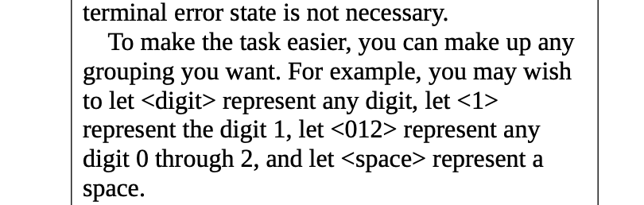
Let’s work on just part of HW 4
What does <012> or <digit> look like in the math of RegEx?

Slide 6
Review of Grammar Definition

Slide 7
What are the components of a grammar?

Slide 8
What are the components of a grammar?
Terminals
Non-terminals
Starting non-terminals
Productions

Slide 9
What are the components of a grammar?
Terminals
Non-terminals
Starting non-terminals
Productions
Let T = {0,1,2}
Make up a grammar that generates the language 01*2
Use S as your starting non-terminal

Slide 10
How do you tell if a grammar is context free?
Is the grammar context free?
Which of the following is true?
Let T = {0,1,2}
Make up a grammar that generates the language 01*2

Slide 11
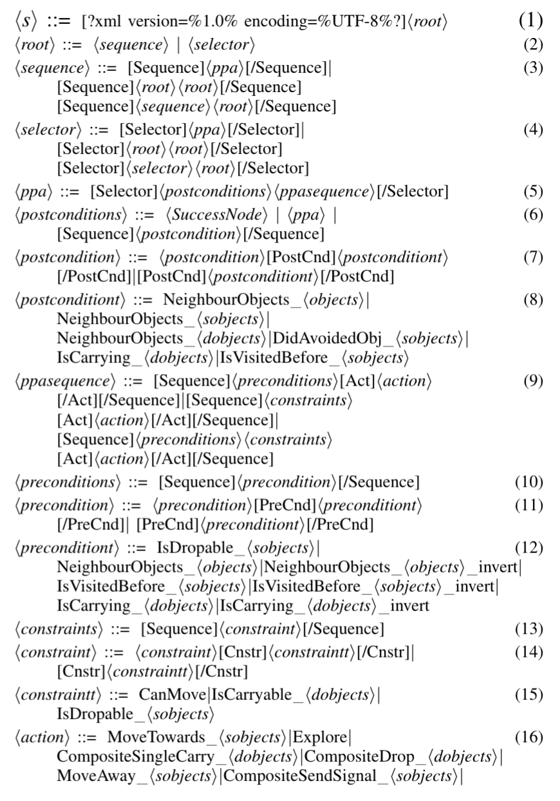
Grammar Elements
Terminals
Non-terminals
Starting non-terminals
Productions
An example grammar from my research
written in BNF (Backus Naur Form).
Which are terminals? Non-terminals?

Slide 12
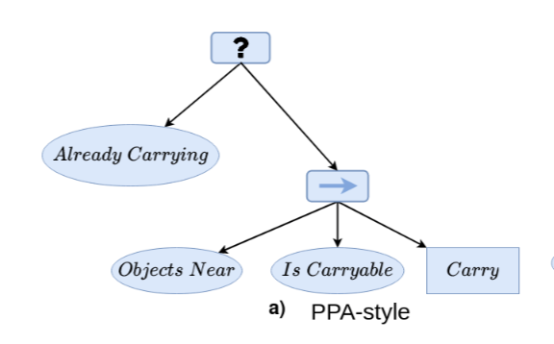
Grammar Elements
Terminals
Non-terminals
Starting non-terminals
Productions
I’m not showing the derivation tree.
I’m showing the program constructed from the grammar.
The program just happens to be a tree.
(Technically, this type of program is called an expression tree.)

Slide 13
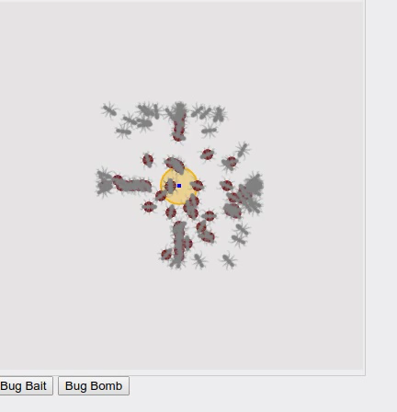
Grammar Elements
Terminals
Non-terminals
Starting non-terminals
Productions

Slide 14
Grammar Elements
Terminals
Non-terminals
Starting non-terminals
Productions
We had to use the tools in today’s
lecture to make this grammar work

Slide 15
Practice with Derivation Trees
I go back and forth between saying “derivation tree” and “parse tree”. Sorry

Slide 16
Project 2
(SCHEMES,"Schemes",1)
(COLON,":",1)
(ID,"snap",2)
(LEFT_PAREN,"(",2)
(ID,"S",2)
(COMMA,",",2)
(ID,"N",2)
(COMMA,",",2)
(ID,"A",2)
(COMMA,",",2)
(ID,"P",2)
(RIGHT_PAREN,")",2)
(ID,"HasSameAddress",3)
(LEFT_PAREN,"(",3)
(ID,"X",3)
(COMMA,",",3)
(ID,"Y",3)
(RIGHT_PAREN,")",3)
(FACTS,"Facts",5)
(COLON,":",5)
(EOF,"",14)
datalogProgram -> SCHEMES COLON scheme schemeList FACTS COLON EOF
schemeList -> scheme schemeList | lambda
scheme -> ID LEFT_PAREN ID idList RIGHT_PAREN
idList -> COMMA ID idList | lambda
Grammar

Slide 17
Project 2
(SCHEMES,"Schemes",1)
(COLON,":",1)
(ID,"snap",2)
(LEFT_PAREN,"(",2)
(ID,"S",2)
(COMMA,",",2)
(ID,"N",2)
(COMMA,",",2)
(ID,"A",2)
(COMMA,",",2)
(ID,"P",2)
(RIGHT_PAREN,")",2)
(ID,"HasSameAddress",3)
(LEFT_PAREN,"(",3)
(ID,"X",3)
(COMMA,",",3)
(ID,"Y",3)
(RIGHT_PAREN,")",3)
(FACTS,"Facts",5)
(COLON,":",5)
(EOF,"",14)
datalogProgram -> SCHEMES COLON scheme schemeList FACTS COLON EOF
schemeList -> scheme schemeList | lambda
scheme -> ID LEFT_PAREN ID idList RIGHT_PAREN
idList -> COMMA ID idList | lambda
Grammar
What are the terminals?
What are the non-terminals?
How many productions are there?
Is the grammar context free?

Slide 18
Project 2
(SCHEMES,"Schemes",1)
(COLON,":",1)
(ID,"snap",2)
(LEFT_PAREN,"(",2)
(ID,"S",2)
(COMMA,",",2)
(ID,"N",2)
(COMMA,",",2)
(ID,"A",2)
(COMMA,",",2)
(ID,"P",2)
(RIGHT_PAREN,")",2)
(ID,"HasSameAddress",3)
(LEFT_PAREN,"(",3)
(ID,"X",3)
(COMMA,",",3)
(ID,"Y",3)
(RIGHT_PAREN,")",3)
(FACTS,"Facts",5)
(COLON,":",5)
(EOF,"",14)
datalogProgram -> SCHEMES COLON scheme schemeList FACTS COLON EOF
schemeList -> scheme schemeList | lambda
scheme -> ID LEFT_PAREN ID idList RIGHT_PAREN
idList -> COMMA ID idList | lambda
Grammar
String to derive
using the grammar

Slide 19
Show a derivation of part of the string using a parse tree
(SCHEMES,"Schemes",1)
(COLON,":",1)
(ID,"snap",2)
(LEFT_PAREN,"(",2)
(ID,"S",2)
(COMMA,",",2)
(ID,"N",2)
(COMMA,",",2)
(ID,"A",2)
(COMMA,",",2)
(ID,"P",2)
(RIGHT_PAREN,")",2)
(ID,"HasSameAddress",3)
(LEFT_PAREN,"(",3)
(ID,"X",3)
(COMMA,",",3)
(ID,"Y",3)
(RIGHT_PAREN,")",3)
(FACTS,"Facts",5)
(COLON,":",5)
(EOF,"",14)
datalogProgram -> SCHEMES COLON scheme schemeList FACTS COLON EOF
schemeList -> scheme schemeList | lambda
scheme -> ID LEFT_PAREN ID idList RIGHT_PAREN
idList -> COMMA ID idList | lambda

Slide 20
Parse Trees give Meaning to Strings

Slide 21
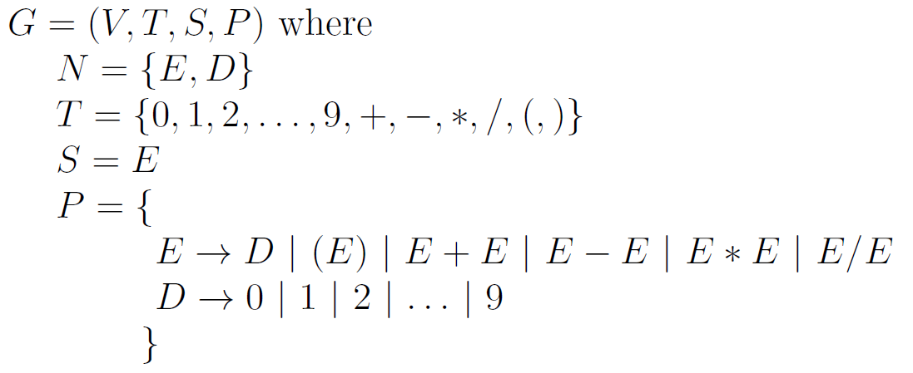
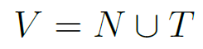
Parse Tree
A parse-tree is a tree that shows the derivation of a string from a grammar
Derive “4+3” from this grammar
We’ll be creating parse trees using leftmost derivations

Slide 22
Parse Tree
A parse-tree is a tree that shows the derivation of a string from a grammar
Derive “4+3” from this grammar

Slide 23
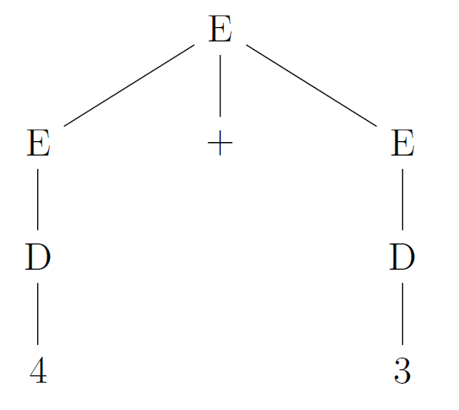
Parse Tree
A parse-tree is a tree that shows the derivation of a string from a grammar
Derive “4+3” from this grammar
We’ll be creating leftmost derived parse trees

Slide 24
Parse Tree
Parse trees are “read” from bottom to top and left to right
Operators lower in the tree are executed first
We evaluate the string in the grammar using the parse tree

Slide 25
What Happens if there are Two Parse Trees for a String
then there is ambiguity in the meaning of the string

Slide 26
Ambiguous Grammars
A grammar is ambiguous if there is more than one leftmost (or rightmost) derivation parse tree for any valid string
Is the grammar above ambiguous?

Slide 27
Ambiguous Grammars
A grammar is ambiguous if there is more than one leftmost (or rightmost) derivation parse tree for any valid string
Is the grammar above ambiguous?
Ambiguity means that there
are two different “meanings”
for some strings

Slide 28
Ambiguous Grammars
A grammar is ambiguous if there is more than one leftmost (or rightmost) derivation parse tree for any valid string
Is the grammar above ambiguous? Yes!
Ambiguity means that there
are two different “meanings”
for some strings

Slide 29
Ambiguous Grammars
Ambiguity means that there
are two different “meanings”
for some strings
Build a parse tree for this string
Example from reading: 7 – 5 * 2

Slide 30
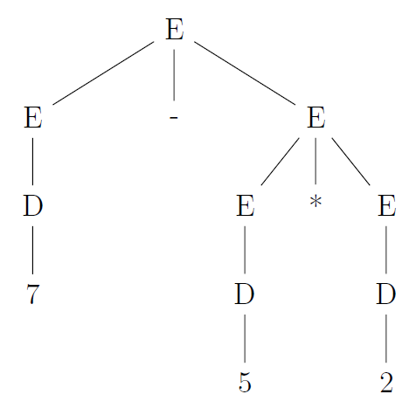
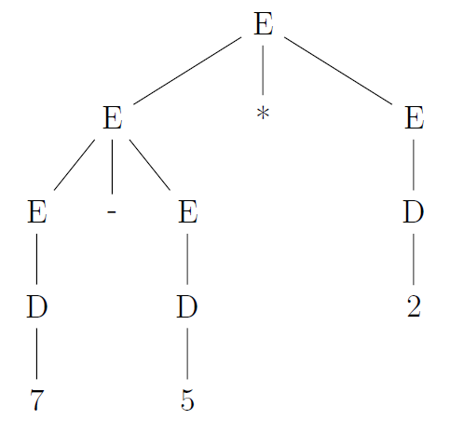
Ambiguous Grammars
Ambiguity means that there
are two different “meanings”
for some strings
Example from reading: 7 – 5 * 2

Slide 31
Ambiguous Grammars
Ambiguity means that there
are two different “meanings”
for some strings.
What are the two meanings?
Example from reading: 7 – 5 * 2
Read bottom to top, left to right

Slide 32
Ambiguous Grammars
Ambiguity means that there
are two different “meanings”
for some strings.
What are the two meanings?
Example from reading: 7 – 5 * 2
7-(5*2)
(7-5)*2

Slide 33
Ambiguous Grammars
Ambiguity means that there
are two different “meanings”
for some strings.
What are the two meanings?
Which is correct?
Example from reading: 7 – 5 * 2
7-(5*2)
(7-5)*2

Slide 34
Two forms of ambiguity
HW
Photo Op
Precedence:
* and / have higher precedence than + and –
the grammar should make sure that * and / are lower in the parse tree since parse trees are read bottom to top
Associativity
7-4-2 should be (7-4)-2 (which equals 1) and not 7-(4-2) (which equals 5)
the grammar should make sure that the 7-4 happens first, so 7-4 should be lower in the tree
minus and plus are left associative operators, meaning they execute left to right

Slide 35
How to Fix Precedence Ambiguity?
Precedence: create new, nonterminals that get operators at the correct level of the parse tree
* and / should be lower in the parse tree than + and –
() should happen lower in the parse tree than anything * and /

Slide 36
How to Fix Precedence Ambiguity?
Precedence: create new, nonterminals that get operators at the correct level of the parse tree
Before
“*” is lower in the
parse tree than “-”

Slide 37
How to Fix Precedence Ambiguity?
HW
Photo Op
Precedence: create new, nonterminals that get operators at the correct level of the parse tree
Before
Change the grammar to push * and / farther from the starting nonterminal than than + and –
Enforcing precedence is done by adding a new nonterminal
After

Slide 38
How to Fix Precedence Ambiguity?
Precedence: create new, non-terminals that get operators at the correct level of the parse tree
Before
After
Create parse tree for
7 – 5 * 2
Observe how E→A→D pushes */ down

Slide 39
How to Fix Associativity Ambiguity?
Create two parse trees for
7 – 3 – 2
Interpret 7-(3-2) vs (7-3)-2

Slide 40
How to Fix Associativity Ambiguity?
Associativity: create new, nonterminals that get associativity at the correct level of the parse tree
Convention: Apply - from left to right
7 – 3 – 2
Interpret 7-(3-2) vs (7-3)-2

Slide 41
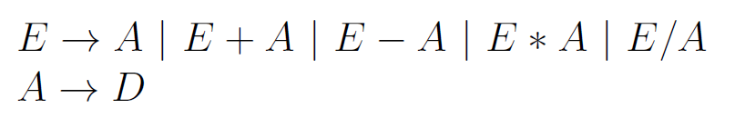
How to Fix Associativity Ambiguity?
Left Recursion pushes leftmost use of
minus lower in the tree
Associativity: create new, nonterminals that get associativity at the correct level of the parse tree
Before
After
HW
Photo Op

Slide 42
How to Fix Associativity Ambiguity?
Left Recursion pushes leftmost use of
minus lower in the tree
Associativity: create new, nonterminals that get associativity at the correct level of the parse tree
Before
After
E on LHS turns into a single E on the RHS
The E on the RHS is at the left side

Slide 43
How to Fix Associativity Ambiguity?
Left Recursion pushes leftmost use of
minus lower in the tree
Associativity: create new, nonterminals that get associativity at the correct level of the parse tree
Before
After
Create parse tree
7 – 3 – 2

Slide 44
How to Fix Associativity Ambiguity?
HW
Photo Op
Associativity: create new, nonterminals that get associativity at the correct level of the parse tree
What about 5^{2^3}?
This is read right to left (first do 2³ and then 5⁸)
Use right recursion E→ A^E

Slide 45
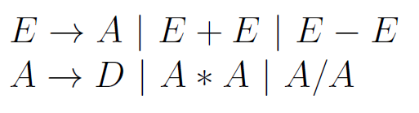
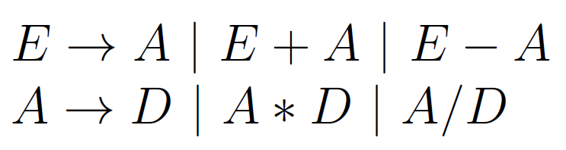
How to Fix Associativity Ambiguity?
Precedence and Associativity
Result of fixing both

